Slide 1


FINANCIAL MANAGEMENT

Slide 2


TABLE OF CONTENTS
SIP
NPS

Slide 3
WHAT IS SIP?
About
A type of Mutual Fund wherein one can invest a fixed amount in a mutual fund scheme at regular intervals
Minimum Investment
Convenience
Withdrawl
Auto-debit every month
Rs.100
Easy and Hasel Free

Slide 4


Regular SIP
Flexible SIP
investors fix an amount for installments and keep paying it
offers flexibility to change the SIP amount as per requirement.
You can invest more when the markets are down to buy more units and vice-versa
TYPES OF SIP
Prepetual SIP
Step-up SIP
investors declare the tenure they wish to stay invested, like for 3 years or 5 years or more
Enable investors to increase or step up the SIP amount at regular intervals

Slide 5


50
40
30
YEARLY RETURN ON SIP MUTUAL FUNDS
20
10
SIPs starting from Rs.100
0
HDFC Index S&P
Axis Small Cap
HDFC Small Cap
ICICI Bluechip Fund
ICICI Commodities
Nippon India Small Cap

Slide 6
Meet Aditi
Meet Anuj

Slide 7
Aditi invests Rs.500 every-month in an SIP of her Choice

Slide 8
Anuj only keeps his money in the bank account

Slide 9
Who do you think will earn more after
1 year?

Slide 10
It’s Aditi

Slide 11
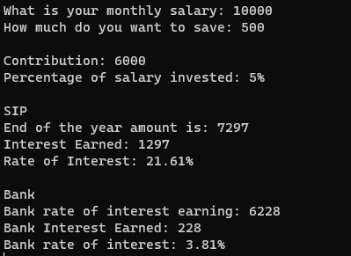
Let’s See How

Slide 12
By Investing in SIP Aditi earned Rs.1297 in a year
Anuj only earned Rs.228 in a year by depositing in the bank.

Slide 13
WHAT IS NPS?
About
Voluntary, defined contribution retirement savings scheme enabling individuals to make optimum decisions regarding their future through systematic savings during their working life.
Eligibilty
Contribution
Redemption Age
18-60 Years
Minimum Rs.500
60 Years

Slide 14
Portable
Flexible
Subscribers can switch over from one investment option to another or from one fund manager to another.
NPS provides seamless portability across jobs and across locations.
BENEFITS OF NPS
Ease of Access
Well Regulated
The NPS account is manageable online and contributions can be also be made online
Regulated by PFRDA, with transparent investment norms, regular monitoring and performance review of fund managers by NPS Trust.

Slide 15
Meet Rukmani

Slide 16
Rukmani is 25 years old
She invests Rs. 600 every month for her retirement

Slide 17
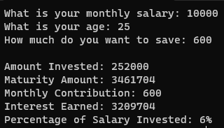
Let’s See How much she will have at maturity

Slide 18
At age 60, Rukmini will have Rs 34 lakh in her NPS account

Slide 19
Out of which she can redeem 60% at the age of maturity i.e. Rs.20 Lakhs
And will receive a monthly pension between Rs 6000-7000 every month

